Slide 1
Rappahannock County Library Board of Trustees Meeting
August 27, 2026

Slide 2
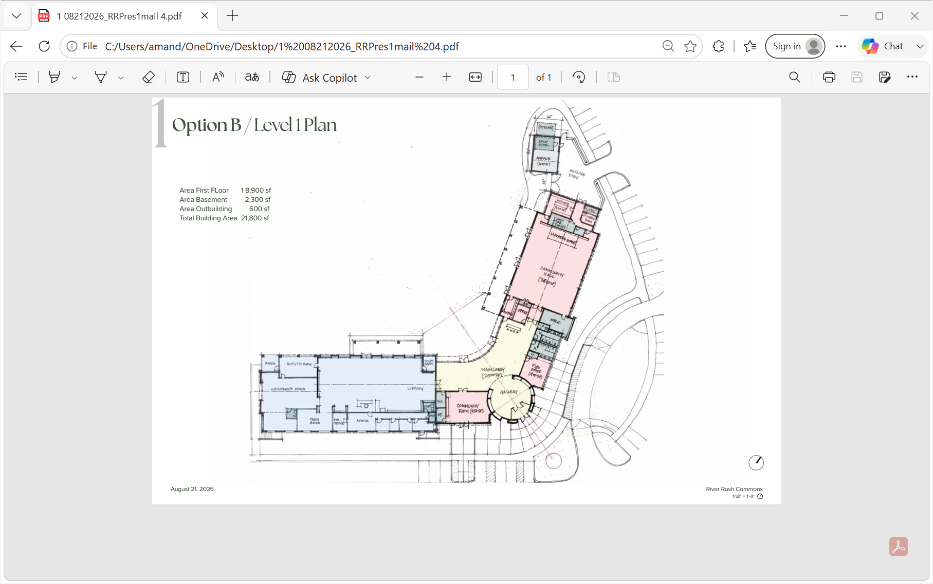

Slide 3
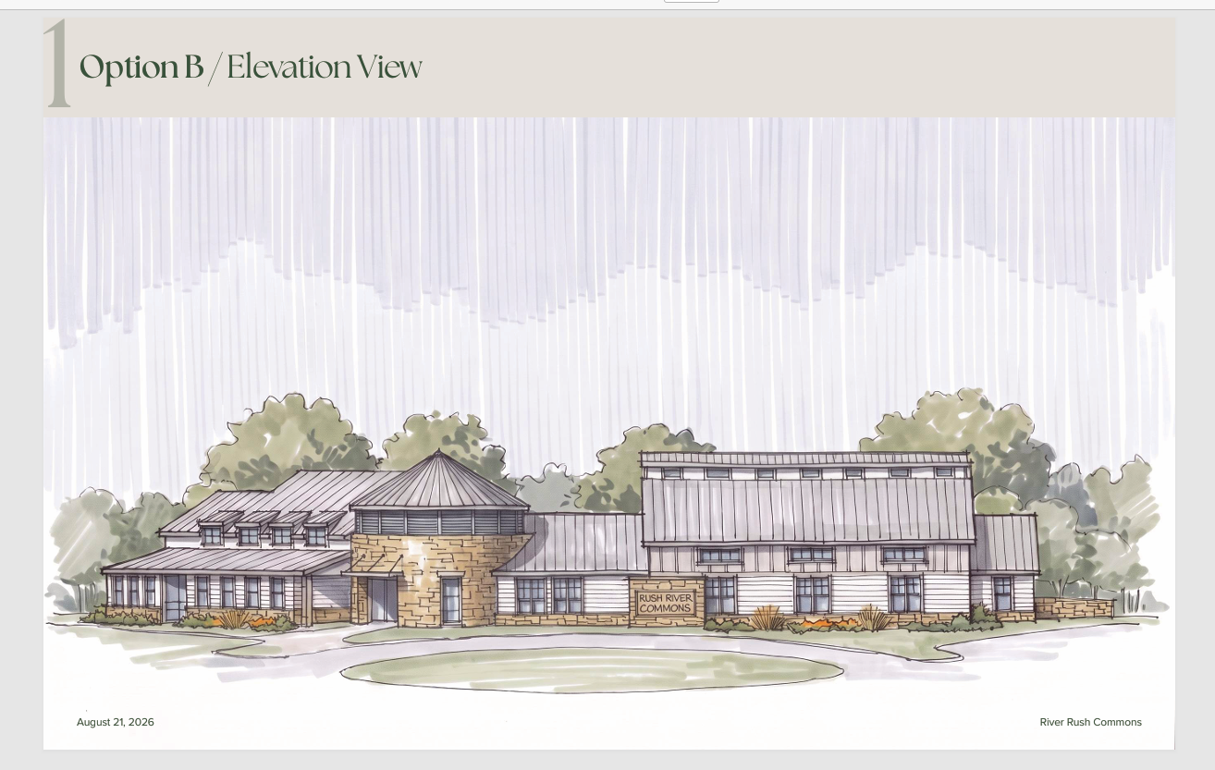

Slide 4
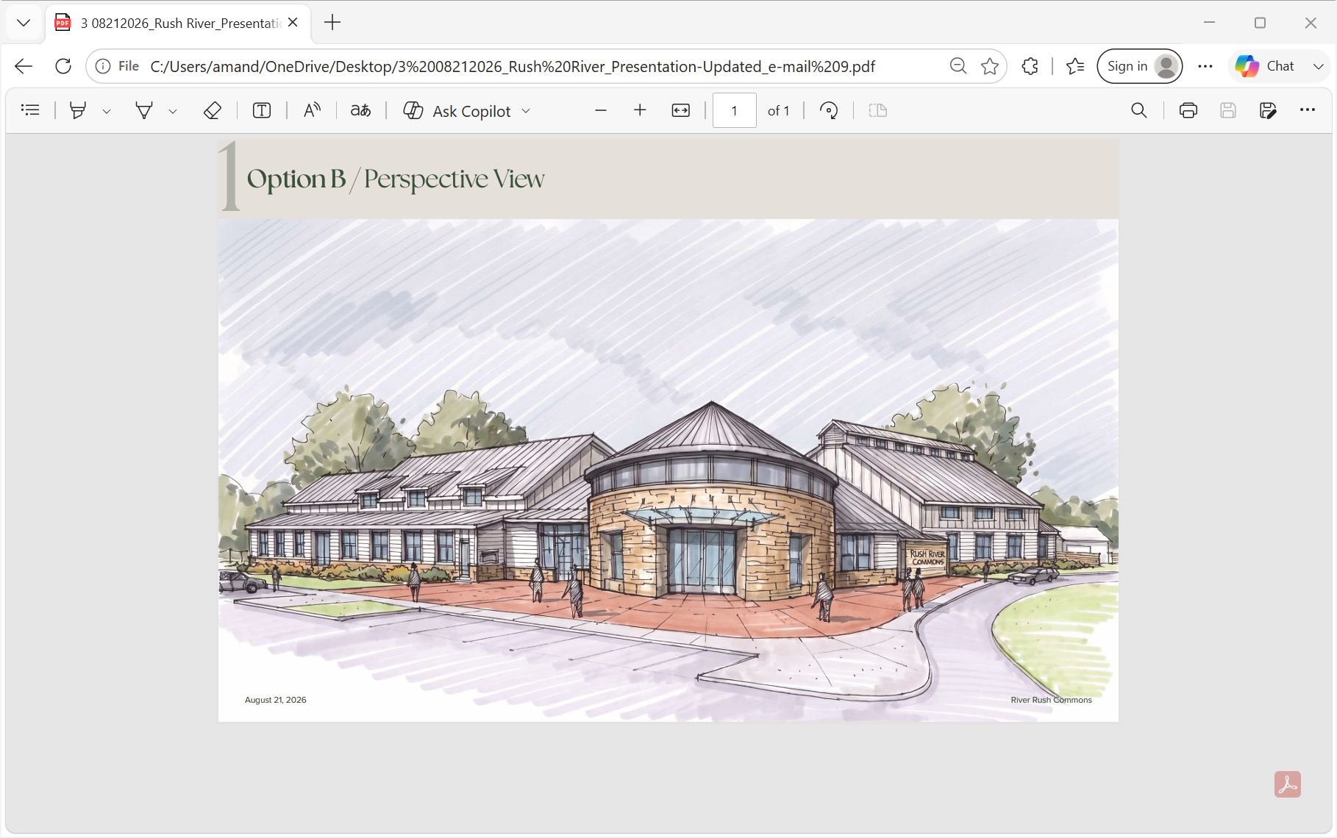

Slide 5
